Slide 1








LAX2015
HAVE FOOD WILL TRAVEL
6-POINT LAX

Slide 2
THIS COURSE IS OFFERED TO ALL STUDENTS WHO HAVE NEVER TAKEN LAX2015
HAVE FOOD WILL TRAVEL

Slide 3







DESCRIPTION
This is a 6-week Hybrid language activity which needs to be done outside of the lecture hours.
In this activity, students plan and produce video reviews (3 online and 2 on-site) on five eateries where one can find unique, affordable and delicious food or drinks.

Slide 4

WHAT DO I HAVE TO DO THROUGHOUT THE 6 WEEKS?

Slide 5
Week | Task
Week 1 & 2 | Student Registration (SMP)
Week 3 | Group Discussion Video 1
Week 4 | Eatery Review Video 1 (Online)
Week 5 | Eatery Review Video 2 (On-Site)
Week 6 | Eatery Review Video 3 (Online)
Week 7 | Eatery Review Video 4 (Online)
Week 8 | Eatery Review Video 5 (On-Site)
WHAT DO I HAVE TO DO THROUGHOUT THE 6 WEEKS?

Slide 6





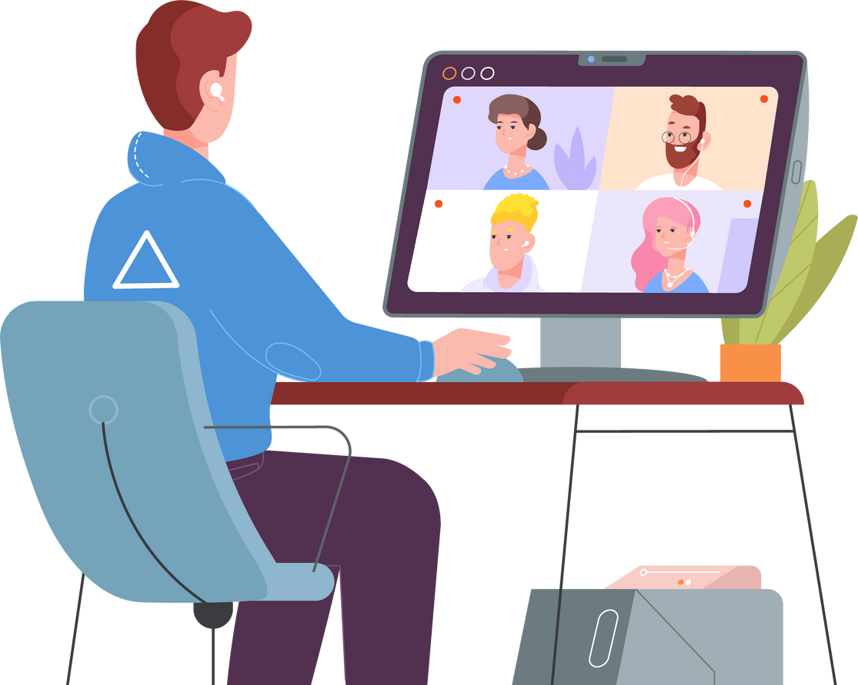
GROUP DISCUSSION VIDEO
12 - 15 minutes long
Submitted on week 3 before the deadline.
Important note:
The video must feature all group members participating actively and speaking for at least 2 minutes.
You need to ensure everyone’s face appears throughout the discussion session

Slide 7

EATERY REVIEW VIDEO
Ensure your video recording is clear (e.g use microphone and tripod/gimbal whenever possible)
Students are required to complete and return the INDEMNITY form to the group instructor before leaving UPM campus for on-site eatery review videos.
In groups of 5-6, students produce one video-recorded review every week on an eatery (3 online and 2 on-site)
Each review is divided into 2 parts.
Please refer to the Notes on Timeline for instructions regarding the online and on-site videos.
:

Slide 8

HOW DO I GET MY LAX MATERIALS?
1.Please go to
calc.upm.edu.my
2.This is the official site for all LAX activities.
3. Please download all documents for your LAX activity (Timeline, Briefing Slides, Submission Form and etc.) from the official site.

Slide 9

VISIT THE CALC WEBSITE/ PUTRABLAST AND ENSURE THAT YOU:
Print out
Print out the Timeline from the website so that you know what to do and what to submit throughout the 6 weeks.
Check out
Check out your instructor’s welcome note from Putrablast.
If you are the group leader, check out the group’s Google Drive Link in the instructor’s welcome note and join the group Google Drive A.S.A.P using only your UPM student email.
Contact
Contact all group members and set up the date and venue for your group meeting.
Check out
Check out the Instructor List on the website or Putrablast and get your instructor’s contact details.

Slide 10


WHO IS MY INSTRUCTOR?
HOW DO I FIND HIM/HER?
Check PutraBlast.
Your instructor’s name, instructor’s contact details, instructor’s welcome note and Google Drive Link are on PutraBlast.

Slide 11

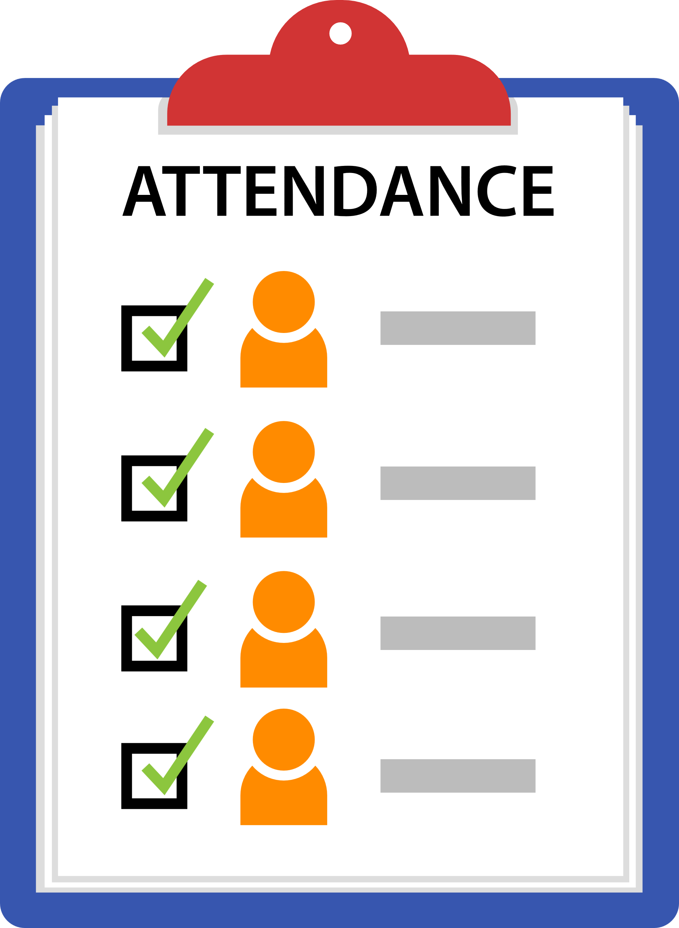
WHAT TO DO?
Decide on the day, date and time of the meeting.
Send your meeting invitation.
Join the meeting using your full names as stated on SMP.
(e.g. Names such as iPhone, Huawei etc. and nicknames
are not acceptable).
Turn on your face cam, and you must be visible throughout the meeting as proof of attendance.
Refer to your instructors if you do not have the ability to do so.

Slide 12

WHAT TO DO?
Only group leader (with UPM student email) should submit:
The Submission Form and video in Google Drive
A copy of the Submission Form at the assignment post on Putrablast before the deadline.
Please refer to the Timeline for tasks that need to be done.
Take note that tasks for LAX conducted virtually might differ from the tasks assigned for face-to-face LAX.
IMPORTANT NOTE:
Complete and return the INDEMNITY form to the group instructor before leaving UPM campus.
Submission Forms should be turned in via Putrablast before the deadline.
Submission Forms that are posted after the deadline or emailed to the instructor will be rejected.
Ensure each recorded video submission on Google Drive does not exceed the maximum size of 100mb a video.

Slide 13



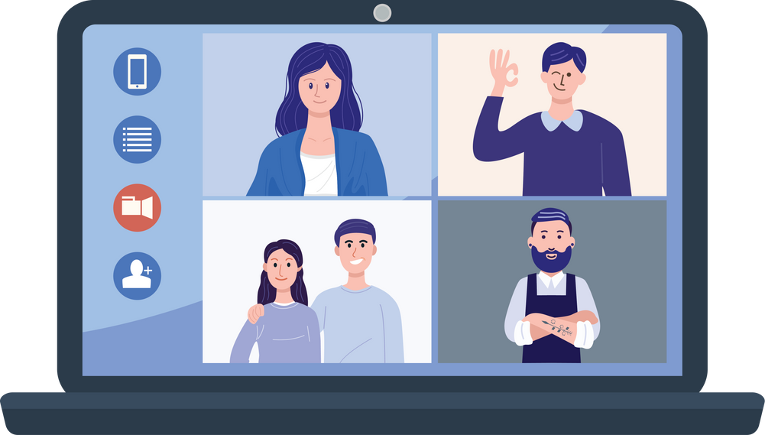




WHEN RECORDING YOUR VIDEO,
PLEASE REMEMBER TO:
Ensure there is no background noise that may affect the clarity of your voice
State the discussion session, e.g. “Today, we are recording group discussion video 1”
Ensure all group members appear on the same screen throughout the recording.
Speak clearly and loudly
Take part actively
State the name(s) of any group members who is/are absent
Introduce yourself at the beginning of each video
Keep to the time-frame
set for each video

Slide 14
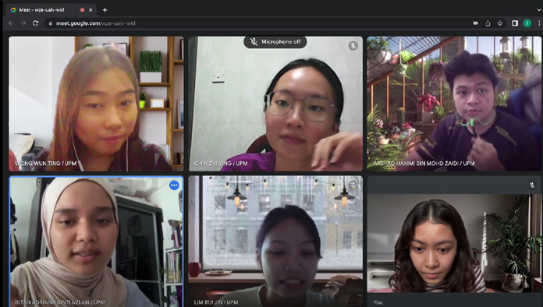

GROUP DISCUSSION VIDEO
Ensure that everyone appears on the screen throughout the discussion.
(Do not submit an individual video recording or a video which is merged as a group video recording from individual videos)

Slide 15





THE GROUP LEADER SHOULD
Upload the group discussion video, Indemnity form and submission form onto Google Drive via the submission link given by his/her instructor.
Turn in a copy of the Submission Form via PutraBlast before the submission deadline. Only ONE submission is required on Google Drive and PutraBlast each week.

Slide 16



ASSESSMENT
Attendance
(100%)
80% and above
Recorded based on participation in the group discussion/reflection videos.
Students are not required to sign any attendance forms.
Students must submit their MCs or excuse letters (if any) if they fail to attend any of the group discussion sessions to avoid being awarded a zero for attendance. (Please contact your respective instructors on how to do this or come to CALC office).
Task completion (100%)
100% + 100% /2 = 100% (M or TM)
Submission of all tasks before the weekly deadline
Participation in the group discussions.
M = Memuaskan (Satisfactory)
TM = Tidak memuaskan
(Non satisfactory/Fail)

Slide 17



ANY QUESTIONS?
Please check out the FAQ section on the website.
If you still cannot find the answer to your question, please contact your instructor directly or send an email to
laxteam.upm@gmail.com

Slide 18





